Slide 1
CSCIU 310 01 Introduction to Computer Architecture AKM Jahangir A Majumder, PhD
Spring 2019 - Lecture 5
January 30, 2019
Note: Some slides are adapted from those used by previous instructors and some slides include figures from the textbook.

Slide 2
Review and Learning Outcomes
We began to cover how a datapath is built to implement MIPS instructions
We will also discuss the following topics:
how the control signal can be generated in a processor
issues of single cycle processor.
HW 2 is posted on Blackboard which is due on Wednesday, Feb 6
We will have quiz 2 on Monday, Feb 11, which will cover Lectures 3-5
Quiz 1 grades and keys are posted on Blackboard
We will discuss feedback on proposal proposal today

Slide 3
Review: J-Format Instructions (1/2)
Define “fields” of the following number of bits each:
6 bits
26 bits
As usual, each field has a name:
opcode
target address
Key Concepts
Keep opcode field identical to R-format and I-format for consistency.
Combine all other fields to make room for large target address.

Slide 4
Review: J-Format Instructions (2/2)
Summary:
New PC = {PC[31..28], target address, 00}
Understand where each part came from!
Note: { , , } means concatenation {4 bits , 26 bits , 2 bits} = 32 bits address
{1010, 11111111111111111111111111, 00} = 10101111111111111111111111111100
Note: Book uses ||, Verilog uses { , , }

Slide 5
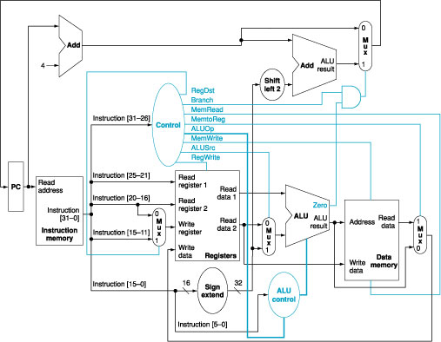
Original Simple Datapath

Slide 6
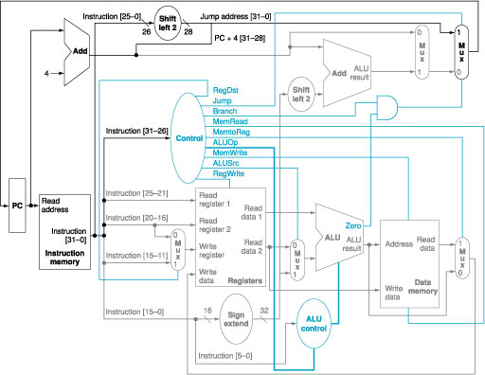
Extended Datapath for Jump Function Implementation
Note: Some Corrections has been made in the figure
1

Slide 7
Control Signal Generation
Simple combinational logic (truth tables)

Slide 8
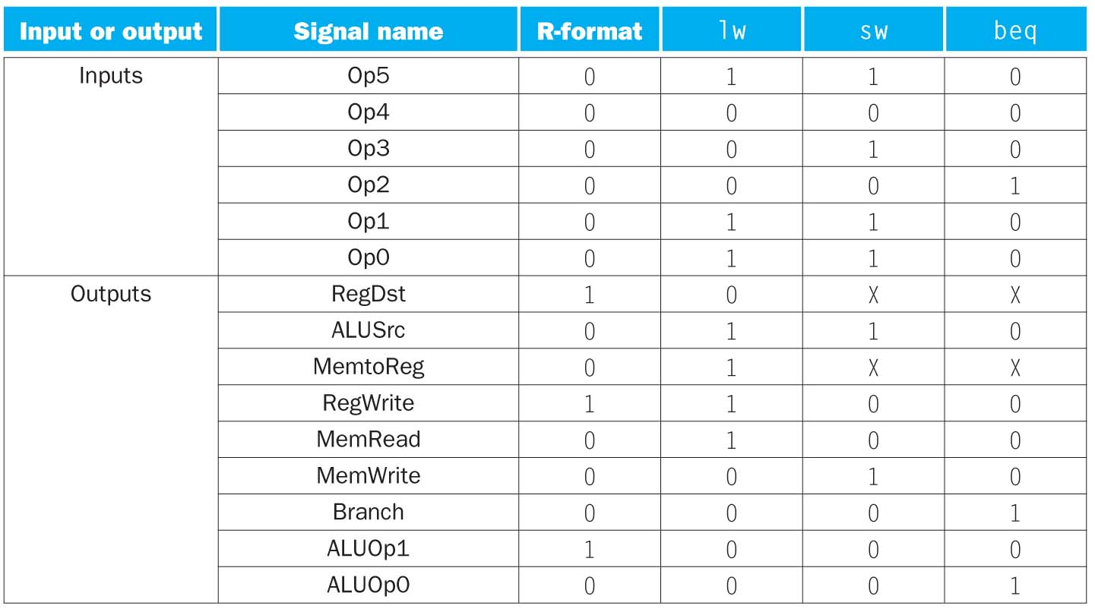

Slide 9
Where we are headed
Single Cycle Problems:
what if we had a more complicated instruction like floating point?
wasteful of area
One Solution:
use a “smaller” cycle time
have different instructions take different numbers of cycles
a “multicycle” datapath:

Slide 10
Single Cycle Computer Performance Issues
Longest delay determines clock period
Critical path: load instruction
Instruction memory → register file → ALU → data memory → register file
Not feasible to vary period for different instructions
Violates design principle
Making the common case fast
We can improve performance by pipelining

Slide 11
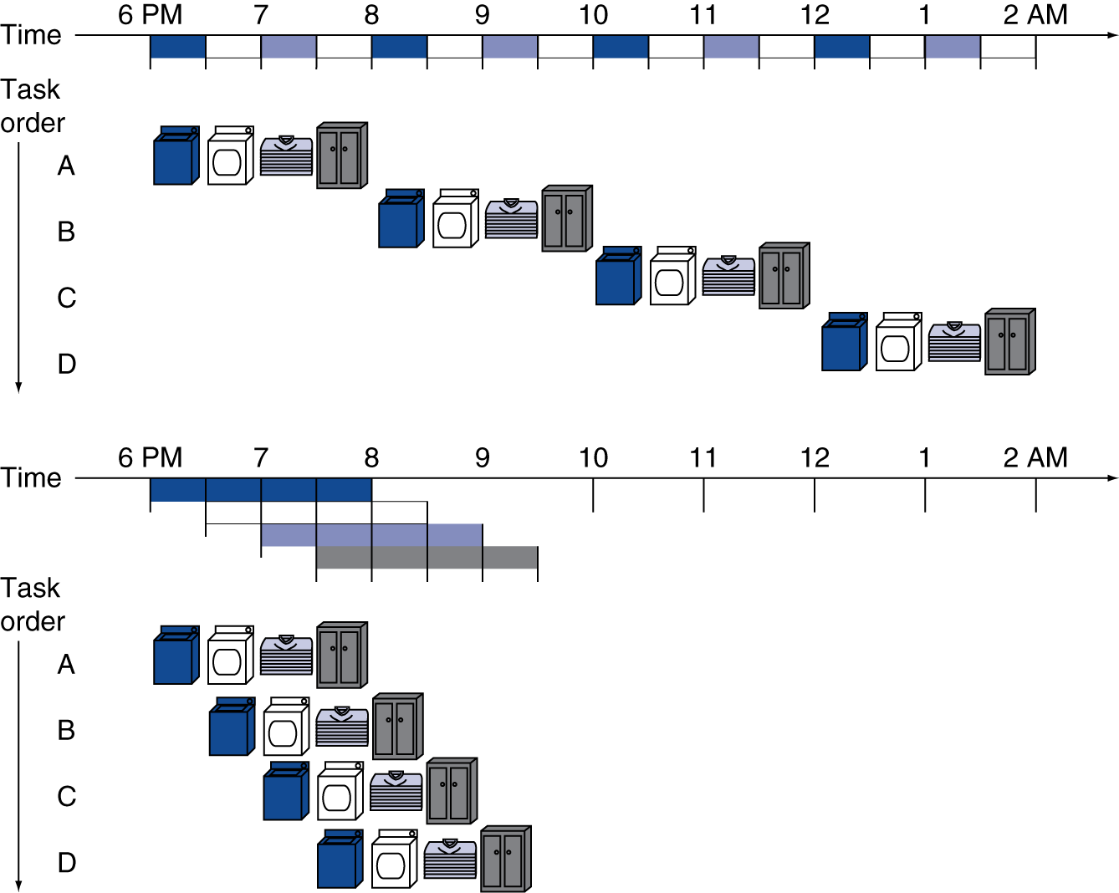
Pipelining Analogy
Pipelined laundry: overlapping execution
Parallelism improves performance
§4.5 An Overview of Pipelining
Four loads:
Speedup = 8/3.5 = 2.3
Non-stop:
Speedup = 2n/0.5n + 1.5 ≈ 4 = number of stages

